Slide 1
Time Management
PULSR

Slide 2
Activities
Concept Document
Domain Research
Requirements Specification
Requirements Validation
Sensor Installation
Software Modeling
User Interface Design
Code Implementation
Software Testing
Software Validation
Software Deployment
Training Schedule

Slide 3
Activity Duration Estimates
Activity | Duration(Days)
Concept Document | 5
Domain Research | 3
Requirements Specification | 2
Requirements Validation | 2
Sensor Installation | 25
Software Modeling | 5
User Interface Design | 15
Code Implementation | 30
Software Testing | 5
Software Validation | 3
Software Deployment | 1
Training Schedule | 20

Slide 4
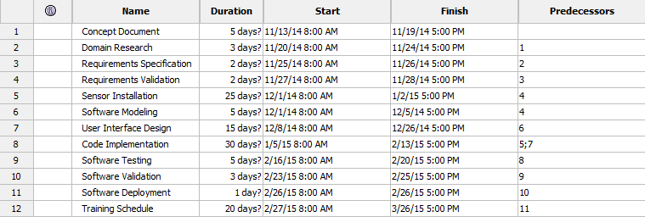
Activity Scheduling

